Slide 1

The Formation of Filter Bubbles

Slide 2

Implementation (Initialization)
Directed network $(V,A)$
Opinion:
$$o :V→\left[0, 1\right]$$
Confidence:
$$c :V→\left[0, 1\right]$$
Trust:
$$w :A→\left[0, 1\right]$$

Slide 3

Implementation (Update values)
Opinion update:
$$o\left(u\right)←o\left(u\right)∙c\left(u\right)+(1−c\left(u\right))∙\sum_{\left(u, v\right)∈A}{w\left(u, v\right)⋅o(v)}$$
Trust update:
$$w\left(u, v\right)←w\left(u, v\right)+\left(1−α\right)⋅(c\left(v\right)−\left|o\left(u\right)−o\left(v\right)\right|)$$

Slide 4
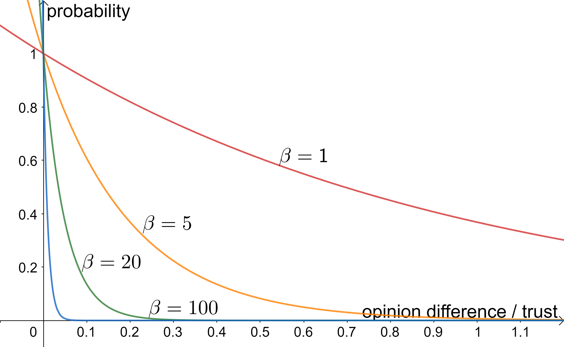
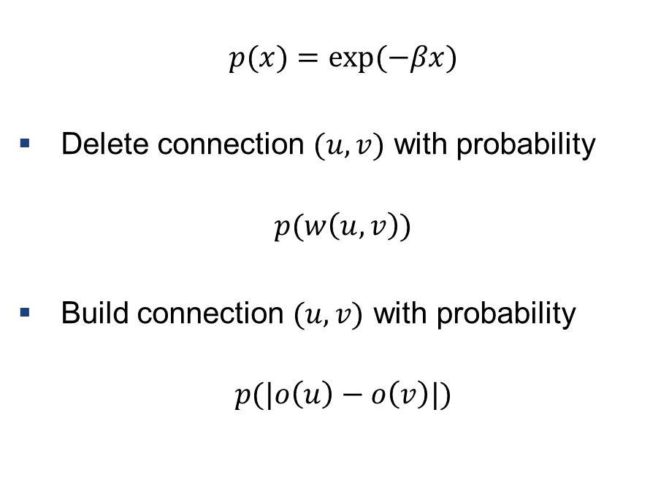
Implementation (Update connections)
$$p(x)=\text{exp}(−βx)$$
Delete connection $(u,v)$ with probability
$$p(w\left(u,v\right))$$
Build connection $(u,v)$ with probability
$$p(|o\left(u\right)−o\left(v\right)|)$$

